Slide 1
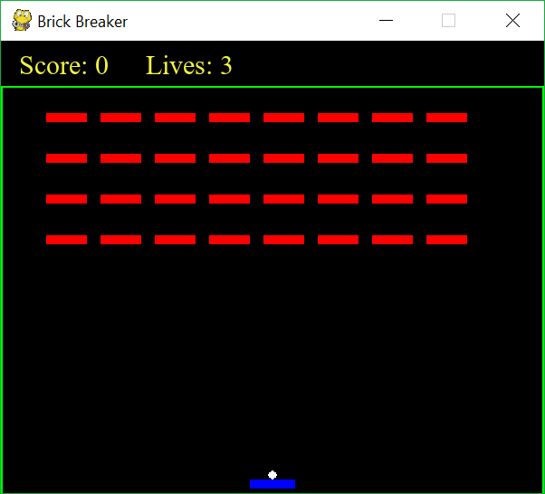
How to make Brick Breaker

Slide 2
Objects for the game
Essential:
Paddle
Ball
Bricks
Optional:
Wall
Game

Slide 3
Paddle object
Obviously, you want just 1 paddle.
Said paddle can be represented as a rectangle.
The paddle will need a speed to move at.
You need collision detection => you must have a Rect attribute (see the Primer/documentation to see why).
You need to draw it every frame.
You need a method to move the paddle.
You need to make sure that it can move off the screen.

Slide 4
Ball object
Can be represented as a ball/circle
Initialised to be on the paddle (thus you need to take into account the bottom of the ball).
It needs a Rect attribute for collision detection
The ball needs a velocity attribute
This should be separated into a horizontal and vertical velocity (M1)
You need to update the ball’s position every frame (as it’s constantly in motion)

Slide 5
Brick object
Simplest object
Basically just draw a rectangle
Give it a Rect attribute (for collision detection)
Draw it every frame

Slide 6
Making the bricks
Obviously, you need more than one brick for this game. So the question is, how do we make more.
Answer: A loop to generate it.
The problem with solution is this, how are we able to tell if the ball should be visible.
Solution 1: Store the bricks in a list
Solution 2: Give the bricks a ‘visible’ attribute
We need to give the coordinates such that they look like this:
Hint: try using more than one loop to generate the coordinates

Slide 7
Collision detection
Collision detection occurs with the ball only. Nonetheless, the ball collides with everything in the game. Namely:
The walls (ball can be reflected horizontally & vertically)
The paddle (ball can be reflected vertically only)
The bricks (horizontally and vertically depending how it hits the brick)
Look up the Primer for collision detections.
Remember to give all your objects a Rect attribute!

Slide 8
Draw the score and number of lives left
Add text to the screen.
Keep track of them using variables
When you hit a brick, your score increases
When the ball’s height is beneath the paddles height (i.e. the ball falls), you lose a life.

Slide 9
Consider how the game changes depending on what the current “state” the game is in.
There are 4 possible states the player can be in:
The game has yet to start (so you’ll need some input to trigger the game to start)
The game is currently in motion
The player has won (i.e. All the bricks have been removed)
The player has lost (i.e. All lives are up and there are still brick remaining)

Slide 10
State 1: The game has yet to start
At this point, the paddle and ball can move around (with the paddle being on the ball)
Press a button to trigger the game (i.e. get the ball in motion)

Slide 11
State 2: The game is playing
This is the most complex state!
You need to constantly update the paddle and ball positions (as they’re dynamic!)
The score and lives are subject to changing
You need to draw the bricks, paddle, ball and score & lives stats every frame.
Need to take into account input for the paddle (i.e. it moves left and right).
The bricks will stop showing up/existing when the ball collides with it
Take into account other types of collision detections.

Slide 12
State 3: The player has won
All the bricks have been eliminated.
Take the user to a different screen.
On this screen, display a message congratulating the player and displaying their score.
Allow the player to replay the game (keyboard input or a button will do)

Slide 13
State 4: The player has run out of lives..
The player loses when the run out of lives (and there are bricks left)
Take them to a new screen.
This screen will display a message and their score.
Allow the user to play the game again (either by entering a certain key or by pressing a button)

Slide 14
Advanced: This is only if you’ve completed the rest of the game
Things to add:
Make the wall visible (easily done with rectangle)
Project the ball at different angles (need knowledge of physics and trigonometry with this one)
Project the ball at different/random speeds
Make different kinds of bricks (some need to be hit twice or thrice before they disappear)
Have a random arrangement of bricks
Make sure that they don’t intersect obviously
Make “levels”.
E.g. Level 1 has 1 row of bricks, level 2 has 2 rows of bricks etc
Add power-ups
E.g. Longer paddle, slower ball
Add power-downs
E.g. Speed the ball up, make the paddle smaller, make all the brick harder to break etc

